Slide 1
Week 7: Lesson 2 MOLES

Slide 2
The mole concept
The mole is the standard chemical unit for describing the amount of a substance in numbers of particles.
The mole is a number equal to 6.02X 10²³, known as Avogadro’s number.
A mole is the amount of substance containing 6.02X 10²³ particles of that substance.

Slide 3
Relative atomic mass
Relative atomic mass compares the mass of an element’s atoms to one twelfth the mass of a carbon-12 atom.
Thus sulphur has a relative atomic mass of 32.07 as its atoms are on average ( allowing for its various isotopes and their abundance) 32.07 times the mass of one twelfth of a carbon-12 atom.
The molar mass(M) of an element is defined as the ‘mass of one mole of its atoms’. For all other elements the molar mass is equal to the element’s relative atomic mass expressed in grams.

Slide 4
Molar mass from chemical formula
Determine molar mass of CH3COOH.
M(CH3COOH)= 2xM ( C )+4 x M (H)+ 2x M (O)
2x 12.01+ 4x 1.008 + 2x 16.00
60.05 g mol⁻¹

Slide 5
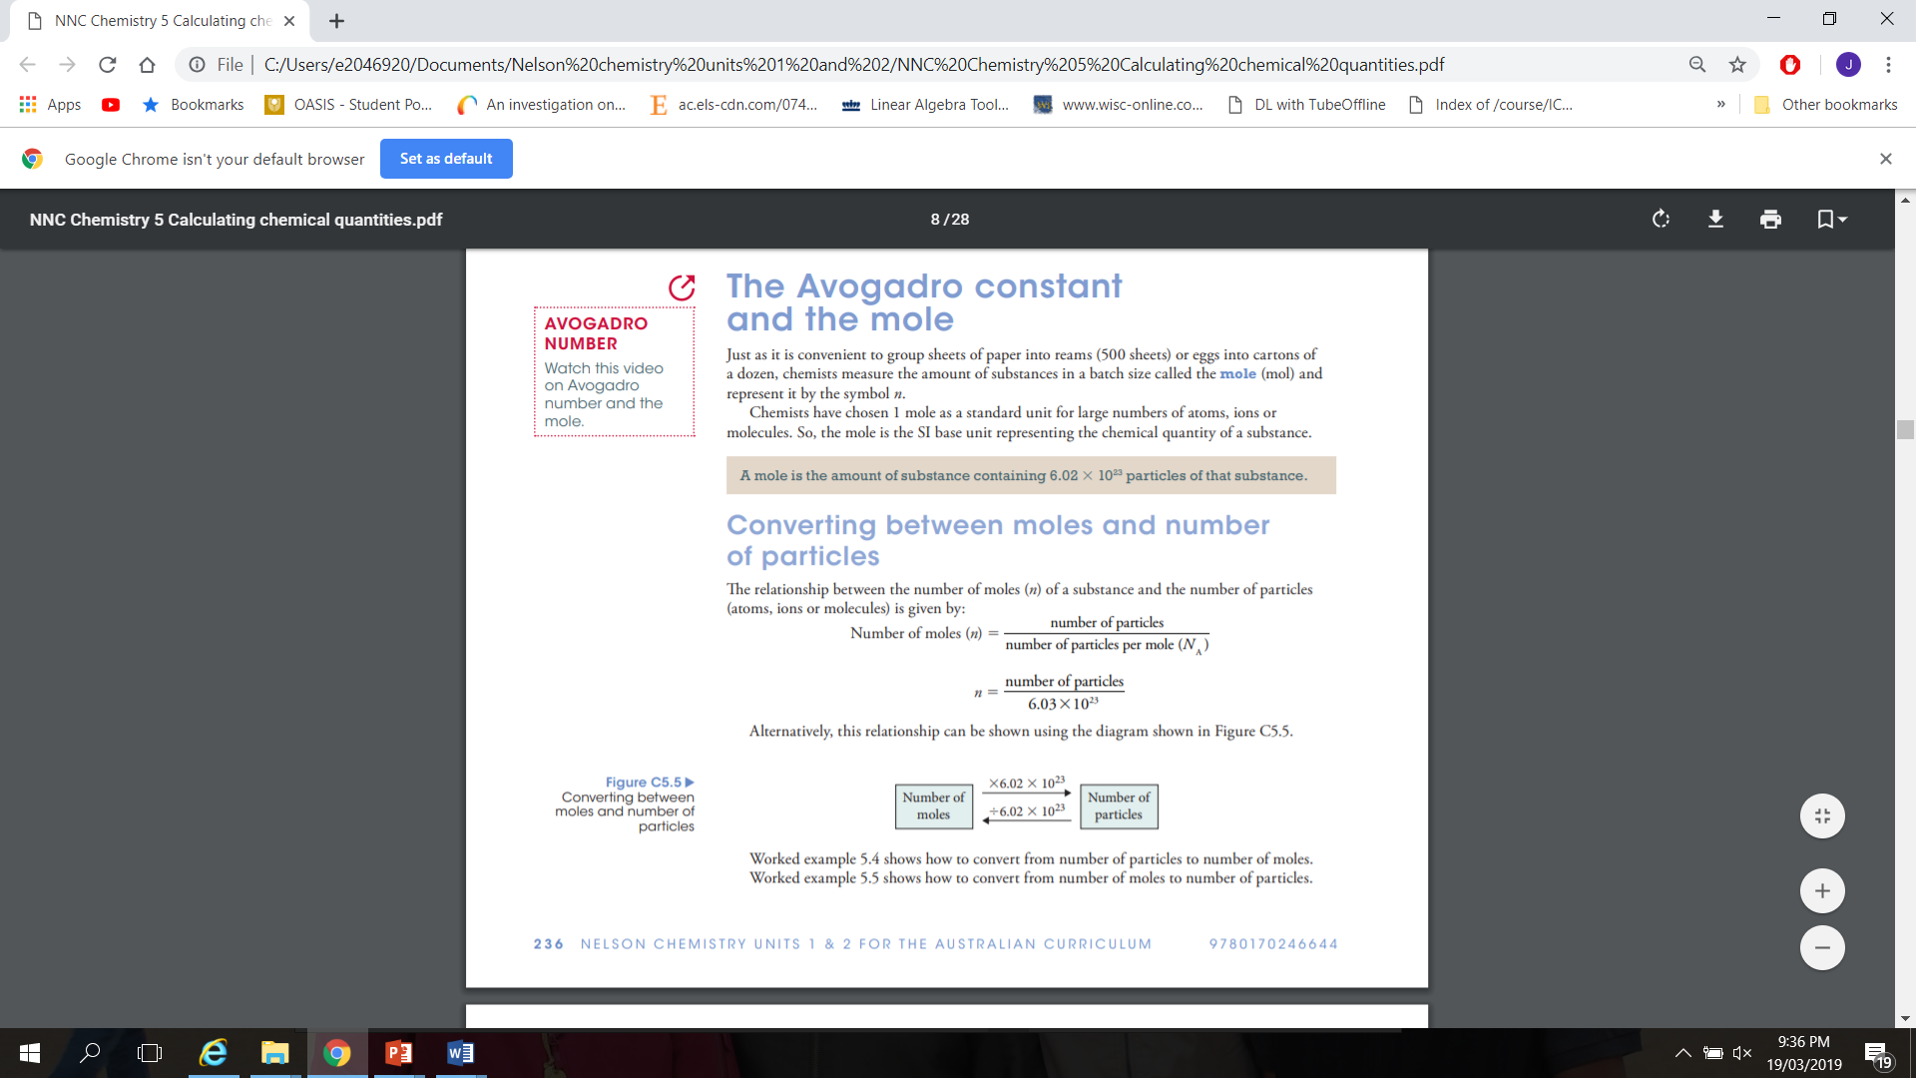

Slide 6
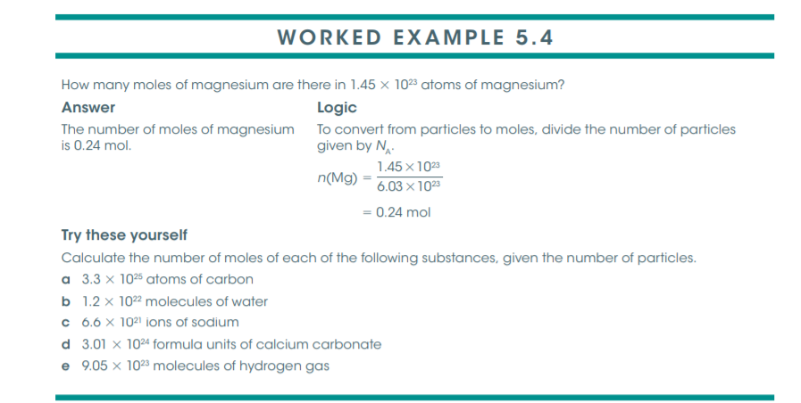

Slide 7
